Slide 1


Machine Learning & Signal Analysis to predict component degradation with ECG data
ISYE 6748 - Applied Analytics Practicum
Team 3: Ahmed R. Memon, Bandana Dhungana, Saisuriya Paranthaman

Slide 2
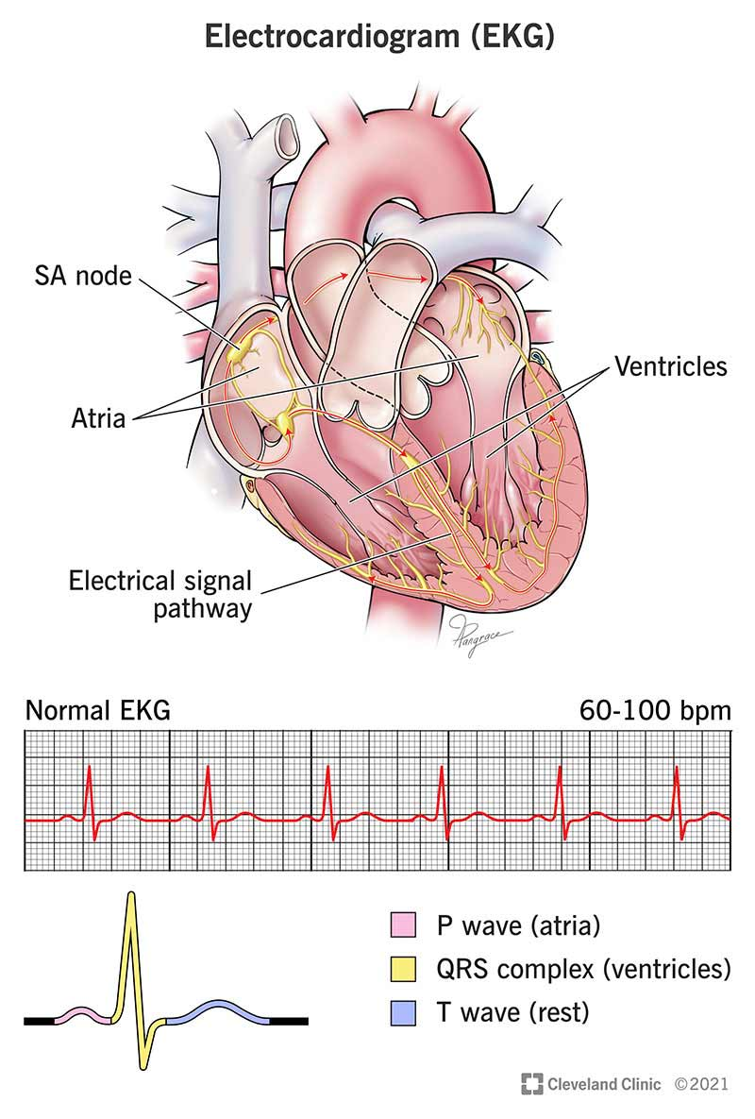
Introduction
ECG signal is a graphical representation of electrical activity of heart to identify heart disease and abnormalities.
Noise and other factors called artifacts can produce spikes in ECG signals
Use of machine learning algorithms to identify the variation of these signals can be beneficial for identification of pattern that could suggest cardiac abnormality.
Fig source : Cleveland clinic [1]

Slide 3

Motivation & Problem Discussion
Cardiovascular disease is one of the leading cause of death, responsible of one third of fatalities globally [2].
Patients with suspected cardiac disorders are required to undergo ECG tests, where cardiologists examine the patterns and variations in the ECG signals.
However, manual analysis of these signals is difficult and prone to inaccuracies.
Achieving more accurate, cost-effective, and automated analysis of these signals using Machine learning algorithms is highly advantageous.
Source: CDC [3]

Slide 4
Project Goals
Perform Machine Learning to classify strong and weak ECG signals
FFT analysis
Classification models (Logistic Regression, Random Forest, SVM)
Predict strong and weak ECG signal using test data.
Regression model (Linear)
Gradient Boosting (XGBoost)
Measure model performance
k fold cross validation
confusion matrix for classification model

Slide 5
Plan overview
Create the data
Feature extraction
Split the data to train and test dataset
Evaluate the model
Use the model

Slide 6
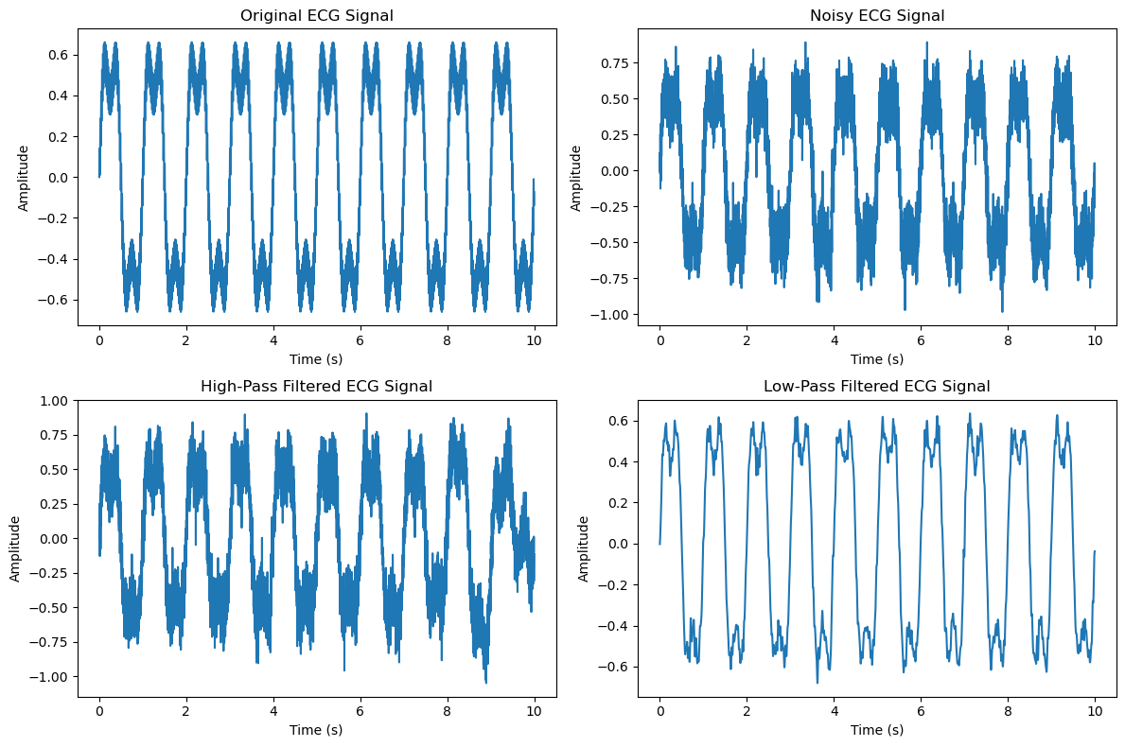
Data Preparation
We will use simulation to create synthetic dataset based on ECG signals.
ECG Signal is synthesized by summing sinusoidal waves at different frequency (1 Hz, 3Hz, 50Hz) to mimic the heart's electrical activity.
Noise is added to the synthetic ECG signals to simulate real-world signal inference.
High-pass and low-pass filters are applied to the noisy signals to remove unwanted frequencies, with a cutoff 0.5Hz and 30Hz respectively.
Short-Time Fourier Transform (STFT) is applied to the original, noisy, high-pass and low-pass signals to analyze their frequency over time.

Slide 7
Creating Data Set for ECG Signals
Have created ECG signals data set based on 3 sinusoids
We will use sampling Freq of 500 Hz. Can experiment if needed
Have applied random noise to the signal to account for variation
Degraded the signals in the dataset and applied the short-term Fourier transformation
Composition of ECG signal
3 sinusoidal components
1 Hz sine wave, which can represent the heart rate
3 Hz sine wave, can represent some higher freq. Component of the ECG signal.
50 Hz sine wave included to add high-frequency content to signal

Slide 8
Short Term Fourier Transformation (STFT)
STFT allows to analyze frequency content of ECG signal and how it changes over time.
Cardiac events such as ischemia, fibrillation, or arrhythmias have distinct freq. Characteristics that can be identified. Using STFT we can detect these abnormalities more effectively
STFT can identify and filter out noise components.
STFT provides features that can capture frequency content of the ECG signal. These features can be used in ML model ability to classify the signal as strong or weak

Slide 9
Progress Up-to-date
We have created a synthetic data set (5000 rows x 13 columns).
First four rows of the dataset is as below.

Slide 10
Next Steps
Improve Synthetic Data
Enhance the synthetic data generation to more closely resemble real ECG signals.
Model Training
Train Logistic Regression, Random Forest, SVM, and XGBoost models.
Validate using k-fold cross-validation.
Feature Enhancement
Explore advanced feature engineering techniques.
Model Optimization
Refine algorithms for greater accuracy.
Tune hyperparameters for optimal performance.

Slide 11

Summary of Workload Distribution
Task | Description | Assigned to
Topic and Dataset finalization | Decide on the project topic and select the dataset to use. | All team members
Proposal slides | Create slides for the project proposal presentation. | Bandana Dhungana
Proposal presentation | Present the proposal | Ahmed R. Memon
FFT analysis | Perform Fast Fourier Transform analysis on the dataset. | Ahmed R. Memon
Classification models | Develop and train classification models on the dataset. | Bandana Dhungana
Regression model | Develop and train a regression model to predict outcomes. | Saisuriya Paranthaman
Midterm slides | Prepare slides for the midterm presentation of the project progress. | All team members
Gradient Boosting | Implement and optimize a Gradient Boosting model for the project. | Ahmed R. Memon
Final report | Compile a comprehensive final report detailing all aspects of the project. | All team members
Final report slides | Create slides summarizing the final report for presentation. | All team members
Final report presentation recording | Record the final report presentation for review or dissemination. | Saisuriya Paranthaman
Team progress will be assessed based on internal milestones.

Slide 12
References
https://my.clevelandclinic.org/health/diagnostics/16953-electrocardiogram-ekg
https://ourworldindata.org/causes-of-death#:~:text=Heart%20diseases%20were%20the%20most,1%2Din%2D7%20deaths.
Ahmad FB, Cisewski JA, Xu J, Anderson RN. Provisional Mortality Data — United States, 2022. MMWR Morb Mortal Wkly Rep 2023;72:488–492. DOI: http://dx.doi.org/10.15585/mmwr.mm7218a3
Notes:
https://www.scribbr.com/citing-sources/cite-an-image/

Slide 13
Thank You!

